Slide 1

Data Structure & Algorithm II Laboratory
(CSE 2118)
Topic : A* Search Algorithm
Deb Kanti Barua: 011 203 024
Mithun Halder : 011 201 041
Sumaiya Akter: 011 191 180

Slide 2
A* Search Algorithm
Here we are giving a presentation on A* search, the name automatically implies that this search techniques deals with search problem.

Slide 3
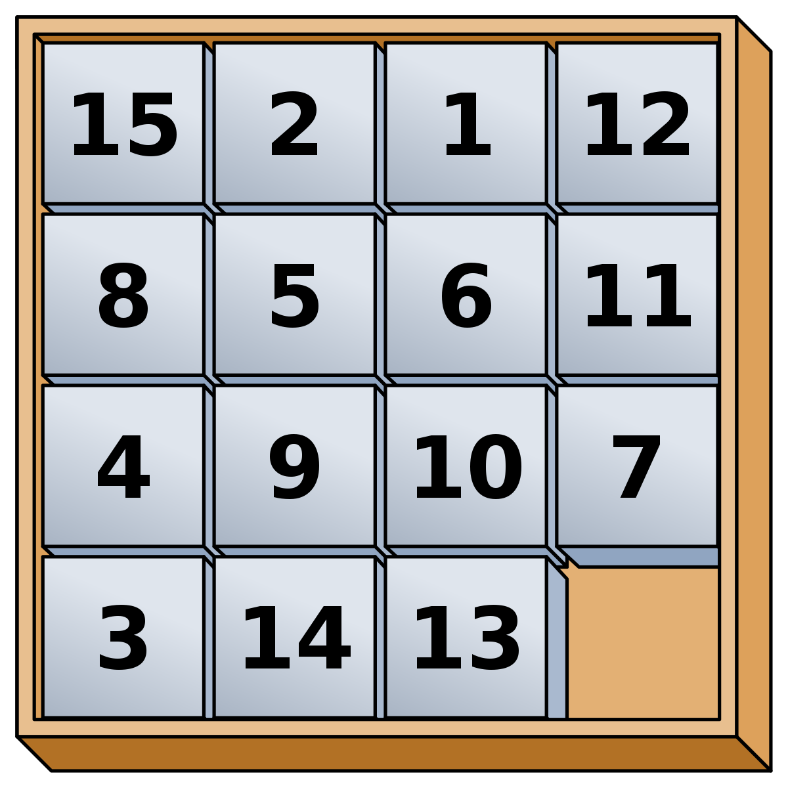
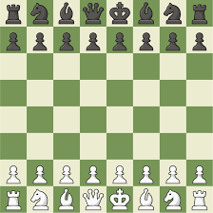

This type of problem can come in lots of different types of formats, like a chess game, a 15 puzzle problem, finding a way to go from point A from B in a maze, even a simpler problem like tic-tac-toe.

Slide 4
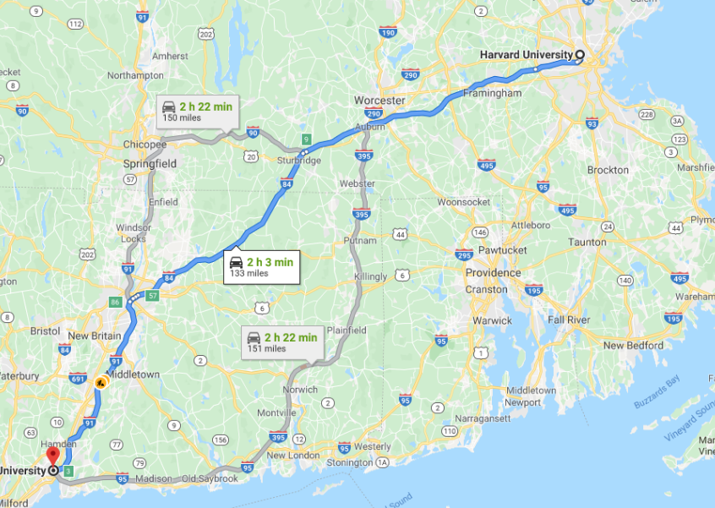
We regular see similar problems like that every day, and also see some intelligent software like google maps solve this problem, by finding the best possible route on that instance (depending on traffic jam and other factors) from a place say, Mohakhali, to a place, say Uttara-11.

Slide 5
Now to get an idea how AI solves them optimally, and our main topic, A* search, we need to get acquainted to some terminologies.

Slide 6

Agent
An agent is an entity, of course software entity, which tries to make sense of its environment as much as possible, and act upon the environment. Like in a road, an agent can be a self-driven AI-powered car, which takes decisions based on its google map-provided environment and takes its routes.

Slide 7
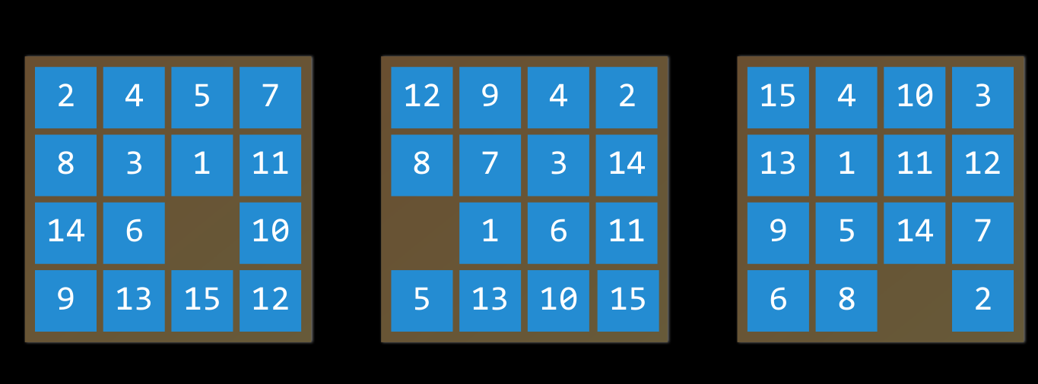
State
A state is some kind of configuration of an agent itself and the environment it is working on. In a 15 puzzle program, a state can be any one of these.

Slide 8
Initial and Goal State
Initial state is just the state in which an agent begins. And goal state is the state that the AI agent will try to reach. In case of google map, it's the destination, in case of tic-tac-toe, it is the winning state.

Slide 9
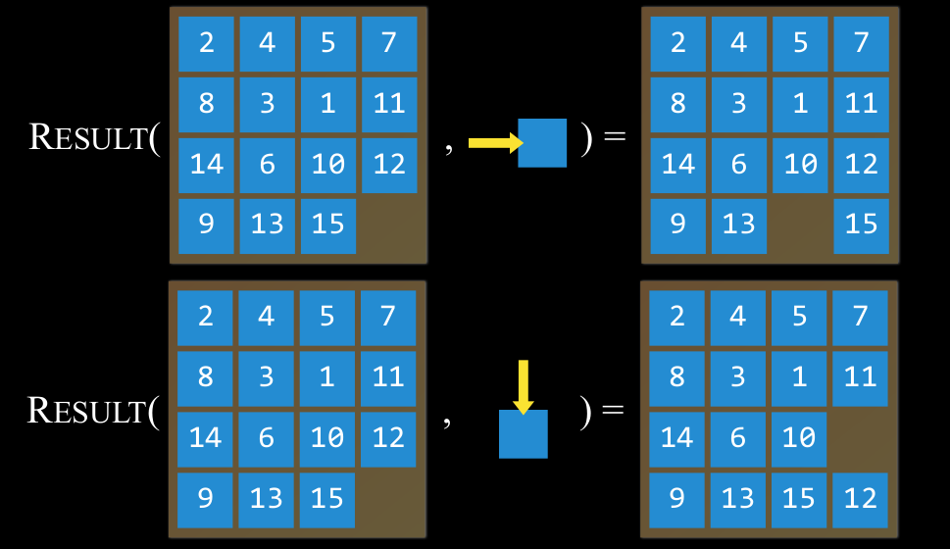
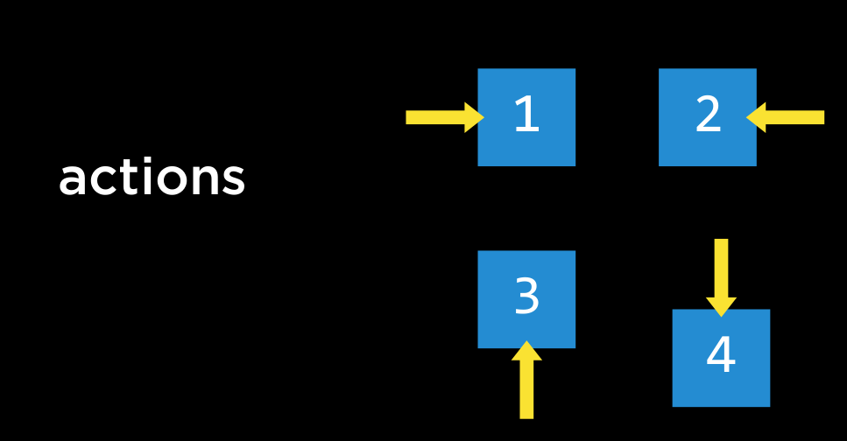
Actions and Transition Model
Actions are the choices that will make the agent to move from one state to another state . And Transition model is a description of what state we get after performing any applicable action in any state. Mathematically, Result(s , a) returns the resulting from performing action a in state s.

Slide 10
How to solve search problem (General approach)
1. Start with a frontier (current state) that contains the initial state
2. Repeat:
If the frontier is empty, no solution
b. Move frontier to the next state based on some choice/algorithm
c. If the frontier reaches the goal state, return the solution
d. Add next nodes of that frontier in some data structure (stack, queue, etc)

Slide 11
We already solve this kind of problem using one of search algorithms called DFS. Where we keep a Frontier list (which works like a stack) and a explored list (so that the agent can't move to same state twice). In DFS, we go deep to find a solution to find the solution state

Slide 12
Another algorithm we already learnt, BFS, which always expands the shallowest node in the frontier. To understand in another way, it is very similar to DFS, but frontier list works as queue. So the next possible states are found in First in first out basis.

Slide 13
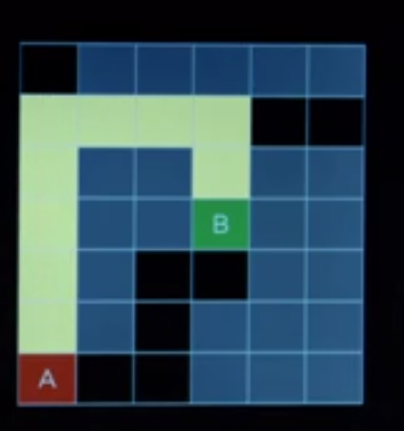
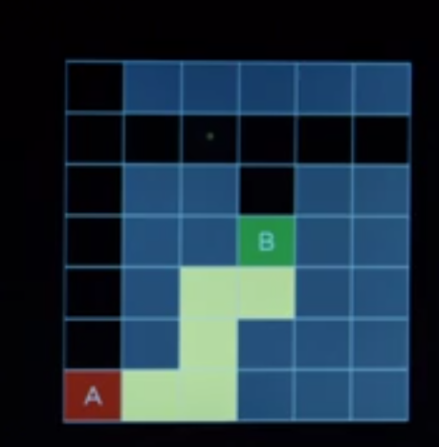
The point is, does DFS give you the optimal solution? not necessarily.

Slide 14
Can BFS work efficiently? Let's look a simulation.

Slide 15
Now Let’s look some more terminologies

Slide 16
Uninformed search
Uninformed search algorithms don't have any additional information about the search space or environment.
DFS AND BFS are uninformed search algorithm. Because they don't have any information about the environment

Slide 17
Informed search
Informed search algorithms have specific knowledge about the environment which can help find solution quickly.
Greedy best first search, A star search are different type of informed search.

Slide 18
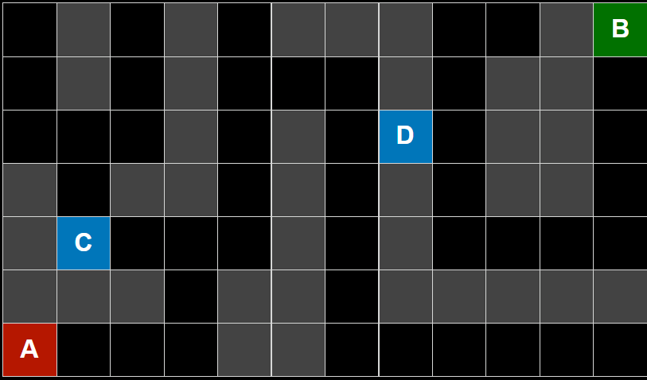
Greedy Best first Search
Instead of blindly search an environment the greedy best first search is going to explore the node which it thinks closure to the goal.
It won't have the exact distance between a node and the goal but it will estimate the distance using a heuristic function h(n).

Slide 19
Heuristic function
Heuristic function will take some node n and estimate the distance between node n and the final state.
Manhattan distance is one kind of heuristic calculation technique which counts total blocks needed for going up or down or left or right from node n to goal state.

Slide 20
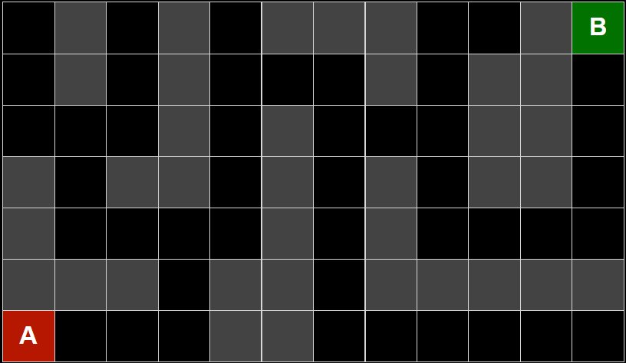
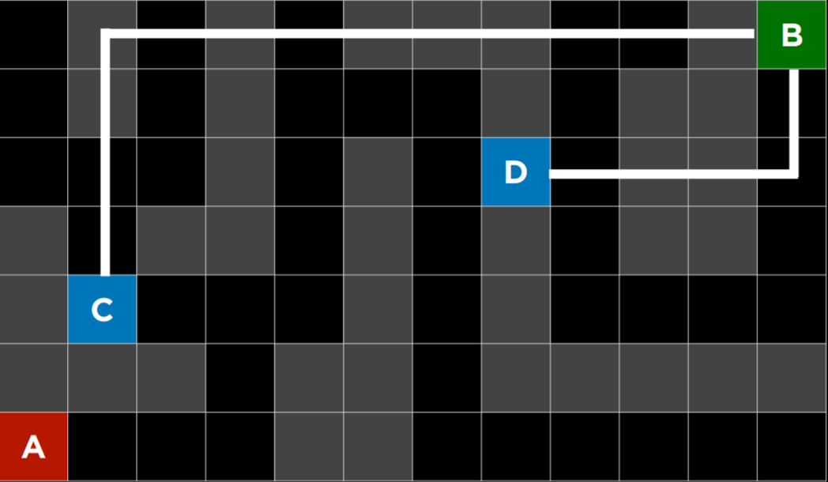

Slide 21
Let’s see a simulation of Greedy Best First Search

Slide 22
Finally, It’s time to talk about A* search algorithm . Why it is a better approach compared to other algorithms . Let’s discuss about it.

Slide 23
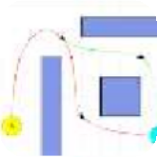
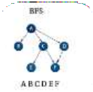
WHAT IS A* ALGORITHM
A * algorithm is a searching algorithm that searches for the shortest path between the initial and the final state
USED IN
Used to calculate the shortest distance between the source (initial state) and the destination (final state).
Path finding
Graph traversal

Slide 24


It is -
COMPLETE
OPTIMAL
A* is to find all the possible solutions that exists for the problem
A* is sure to give you the best solution that is available for the problem

Slide 25

Why A* Algorithm?
Dijkstra does not know when to stop as it does not know which is the best path and tends to compute inefficiently
A* computes the best possible way and stops when the best rout is found. This makes the computation efficient and effective

Slide 26
f(n) = g(n) + h(n)
Estimated cost of cheapest solution
Cost to reach node n from start state
Cost to reach from node n to goal node

Slide 27
How the Optimalism measured in A* Search ?
A* search optimal if
- h(n) is admissible (never overestimates the true cost), and
- h(n) is consistent (for every node n and successor n' with step cost c, h(n) ≤ h(n') + c)

Slide 28
Pseudo - Code :
OPEN = queue containing START
CLOSED = empty set
while lowest rank in OPEN is not the GOAL:
current = remove lowest rank item from OPEN
add current to CLOSED
for neighbors of current:
f(cost) = g(current) + h(current, neighbor)
if neighbor in OPEN and cost less than g(neighbor):
remove neighbor from OPEN, because new path is better
if neighbor in CLOSED and cost less than g(neighbor): ⁽²⁾
remove neighbor from CLOSED
if neighbor not in OPEN and neighbor not in CLOSED:
set g(neighbor) to cost
add neighbor to OPEN
set priority queue rank to g(neighbor) + h(neighbor)
set neighbor's parent to current

Slide 29
Let’s see an example of it!!

Slide 30
Implementation:
Link : https://filebin.net/joxs1pvj0c4c7evk

Slide 31
Advantages:
A* search algorithm is the best path finding algorithm
It is optimal and complete
Used to solve complex problems
Disadvantages:
The main drawback of A* is memory requirement as it keeps all generated nodes in the memory, so it is not practical for various large-scale problems.

Slide 32
Thank You

